Slide 1
TRENDSETTER Q400/Q800
& ACHIEVE T400/T800 Platesetter
Customer Presentation
OCTOBER 2018

Slide 2
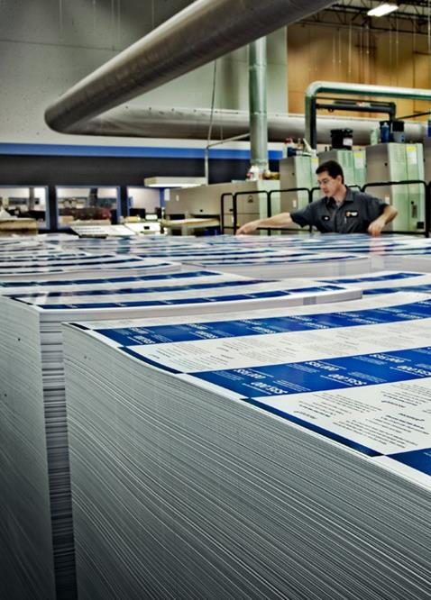
Kodak’s Vision
Making the World a Better Place through Print
Kodak’s Mission
Enable more printers to be profitable and sustainable than any other company in the world

Slide 3
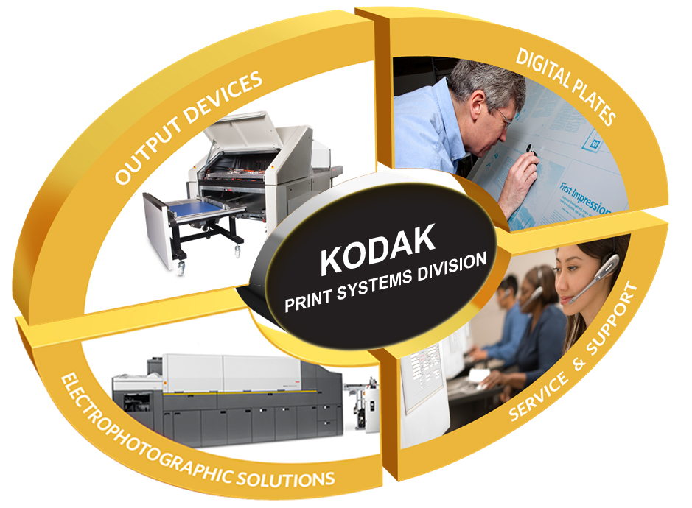
Notes:
PSD designs, manufactures and sells products from three major product groups – Output Devices, Digital Plates, Electrophotographic Solutions – and provides industry-leading Service & Support for printers.

Slide 4
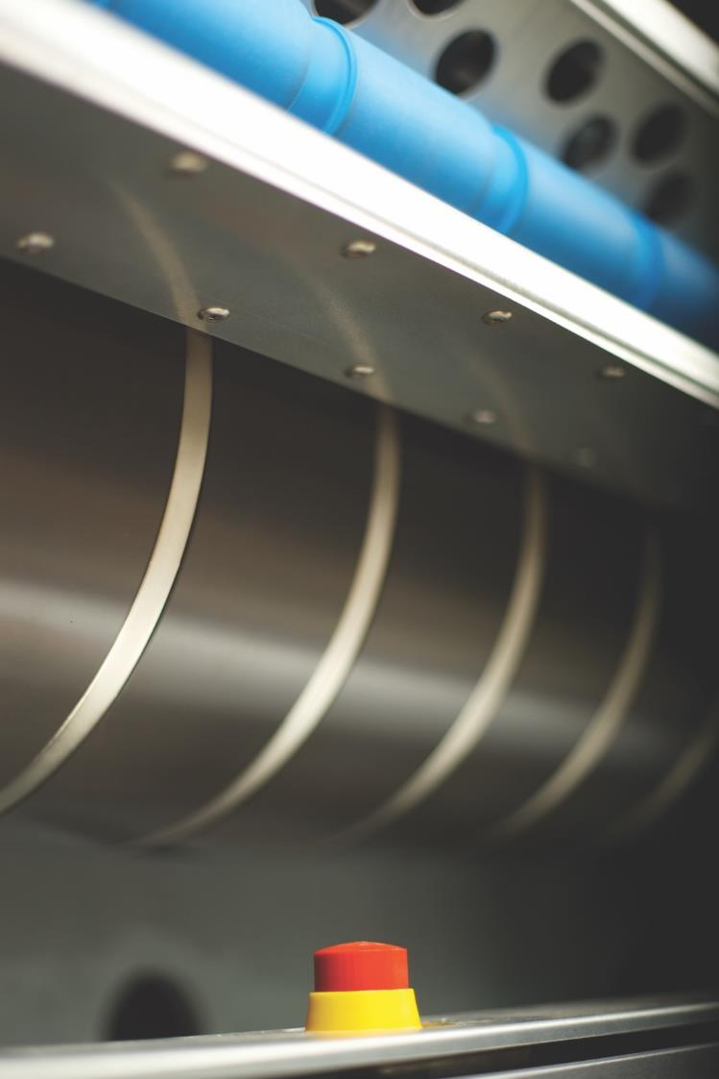
Key strengths
Market-leading reliability, stability and consistency
Affordable automation options
Kodak’s proven SQUARESPOT Imaging Technology
Continued investments in CTP technologies
Worldwide comprehensive service

Slide 5
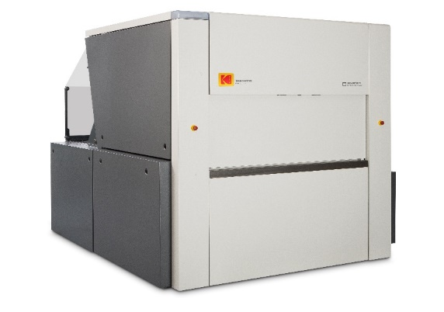
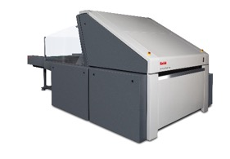
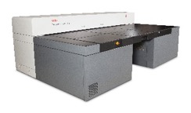
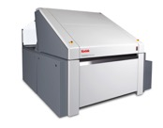
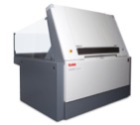

Kodak continues to invest in CTP
2018
2016
MCU Automation
Mobile App
W-Speed Option
JDF/JMF connectivity
2015
In-LINE PUNCH
HIGH RESOLUTION
2014
TRENDSETTER Q2400/Q3600
SCU AUTOMATION
2013
ACHIEVE T400/T800
2012
TRENDSETTER Q1600

Slide 6
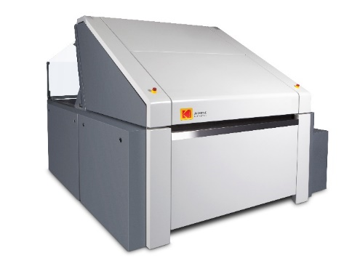
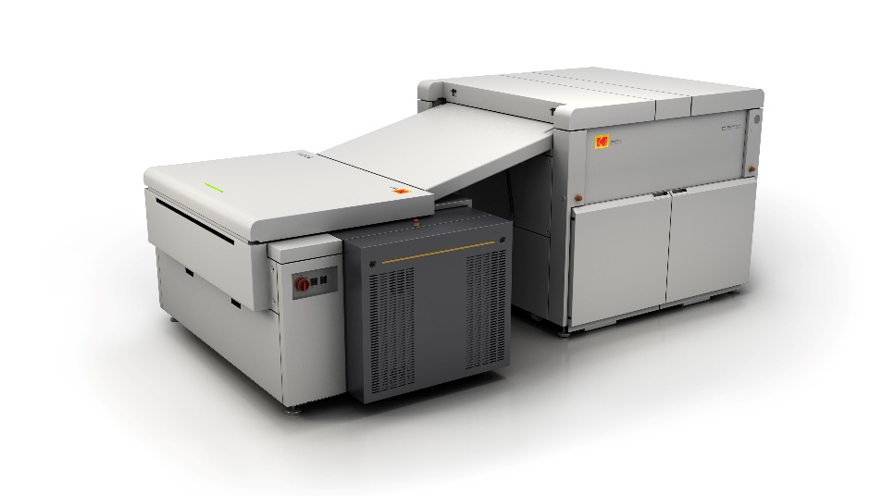
Commercial 4-Page and 8-Page CTP
ACHIEVE T400/T800 Platesetters | Robust, affordable 4-page and 8-page CTP devices
TRENDSETTER Q400/Q800 Platesetters | Market-leading, reliable 4-page and 8-page CTP devices with SQUARESPOT Imaging Technology
MAGNUS Q800 Platesetters | High-performance 8-page CTP devices with SQUARESPOT Imaging Technology

Slide 7
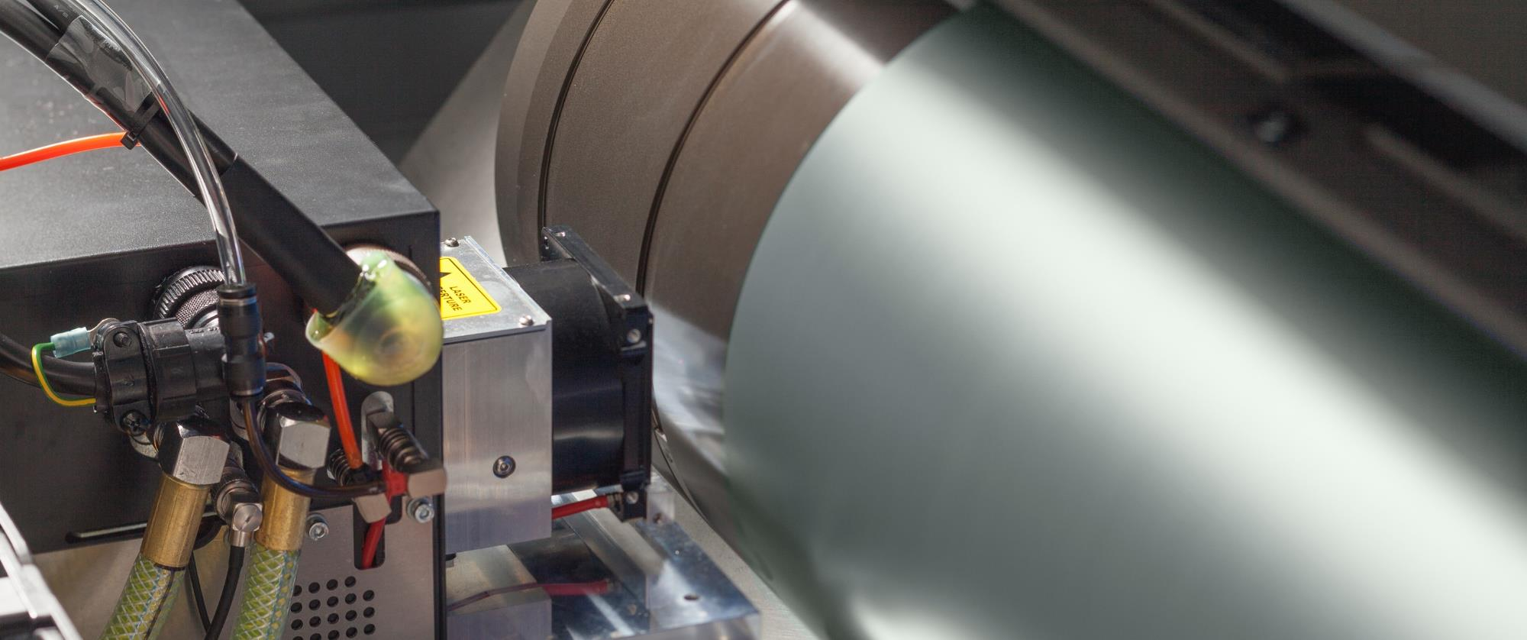
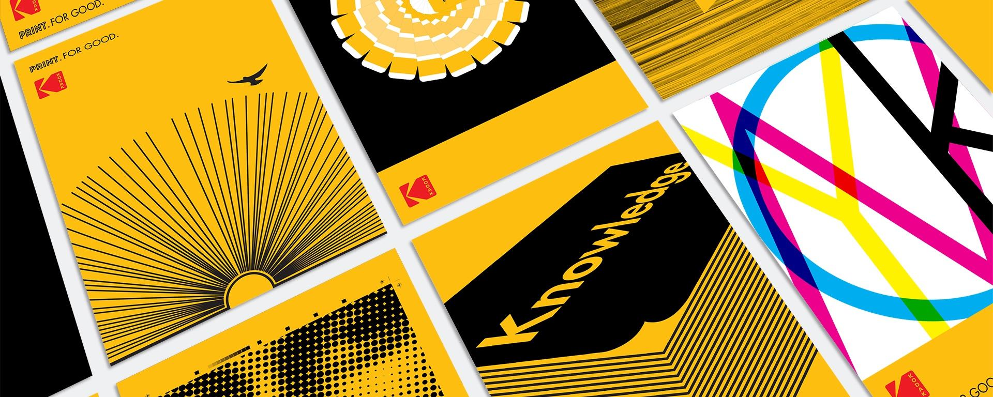
Portfolio highlights

Slide 8
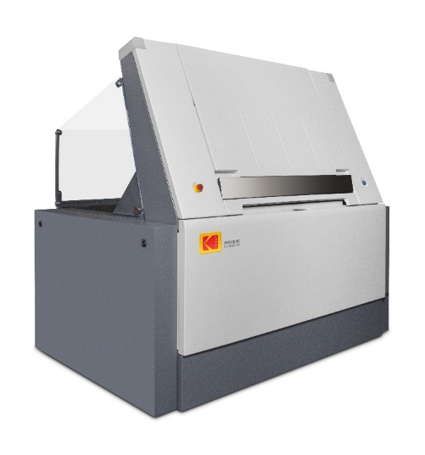
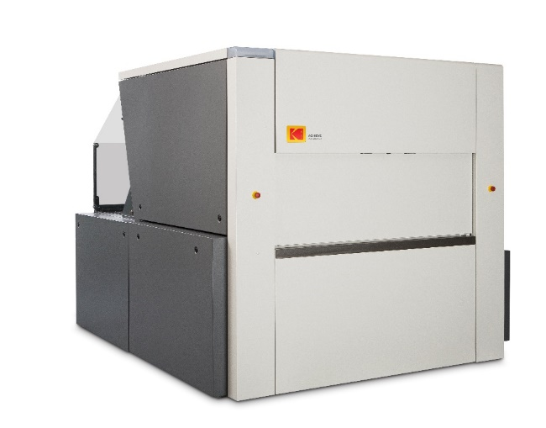
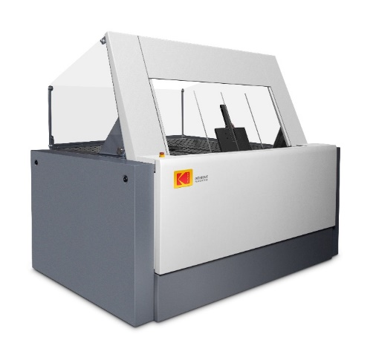

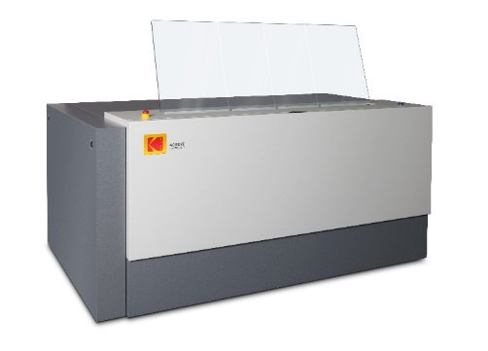
ACHIEVE T400/T800 Platesetters
Robust, affordable CTP device, 4-page or 8-page models
Affordable automation, punch & speed options to fit your business needs and budget
TH5 thermal imaging technology delivers reliability and stability
  Power savings of 43% from its initial design, down to only 400 watts while imaging
Open architecture: JDF/JMF open connectivity, Print Console 5 with TDL & Windows 10 operating system
Remote monitoring with the KODAK Mobile CTP Control App
Automation Options
Semi-Automatic (SA)
Auto Unload( AU)
Autoloader (AL)
Single-Cassette Unit (SCU)
Multi-Cassette Unit (MCU)

Slide 9


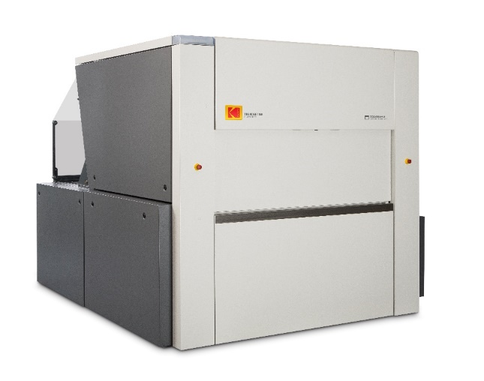



TRENDSETTER Q400/Q800 Platesetters
Market leading, reliable 4-page or 8-page CTP devices delivering productivity and excellent image quality
Automation, DITR film imaging, punch & speed options to fit your business needs and budget
Best-in-class thermal SQUARESPOT Imaging Technology for high quality and stability &
4,800 / 5,080 dpi high resolution option
Power savings of 30% from previous models, down to only 770 watts while imaging
New W-speed option, 75 pph 4-page, 62 pph 8-page
Open architecture: JDF/JMF open connectivity, Print
Console 5 with TDL & Windows 10 operating system
Remote monitoring with the KODAK Mobile CTP Control App
Automation Options
Semi-Automatic (SA)
Auto Unload( AU)
Autoloader (AL)
Single-Cassette Unit (SCU)
Multi-Cassette Unit (MCU)

Slide 10
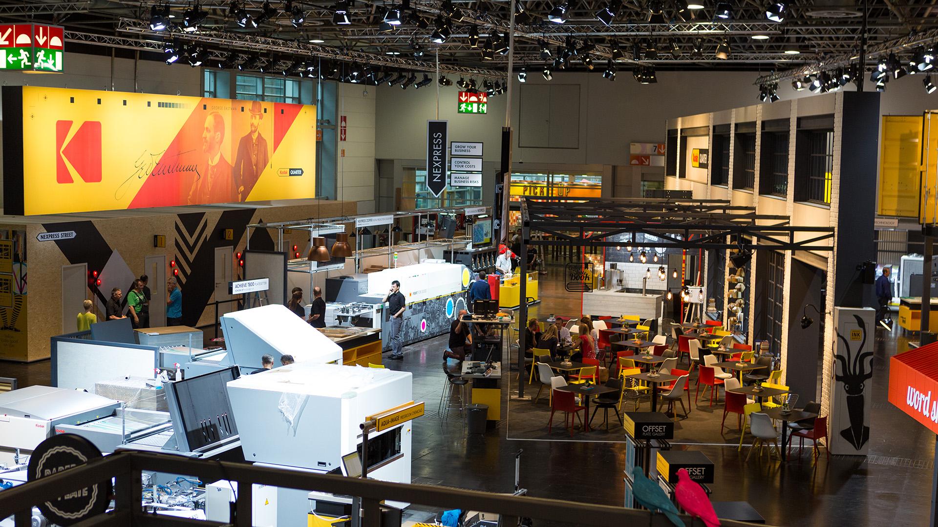

Latest product releases

Slide 11
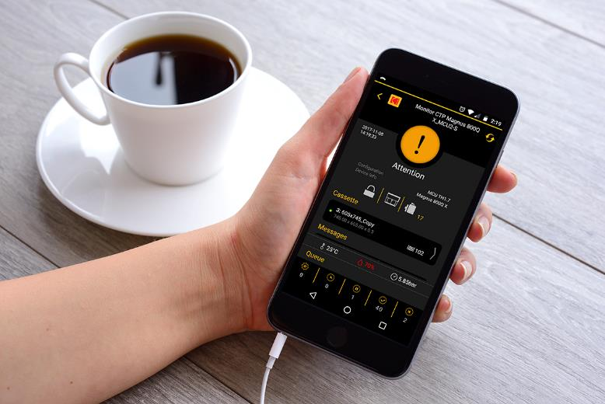
What’s new
Multi-Cassette Unit (MCU)
W-Speed option
Power savings
JDF / JMF open connectivity
4,800 / 5,080 dpi high-resolution option
CTP Mobile Control App
* Available Q2 2017
** Available Mid 2017

Slide 12
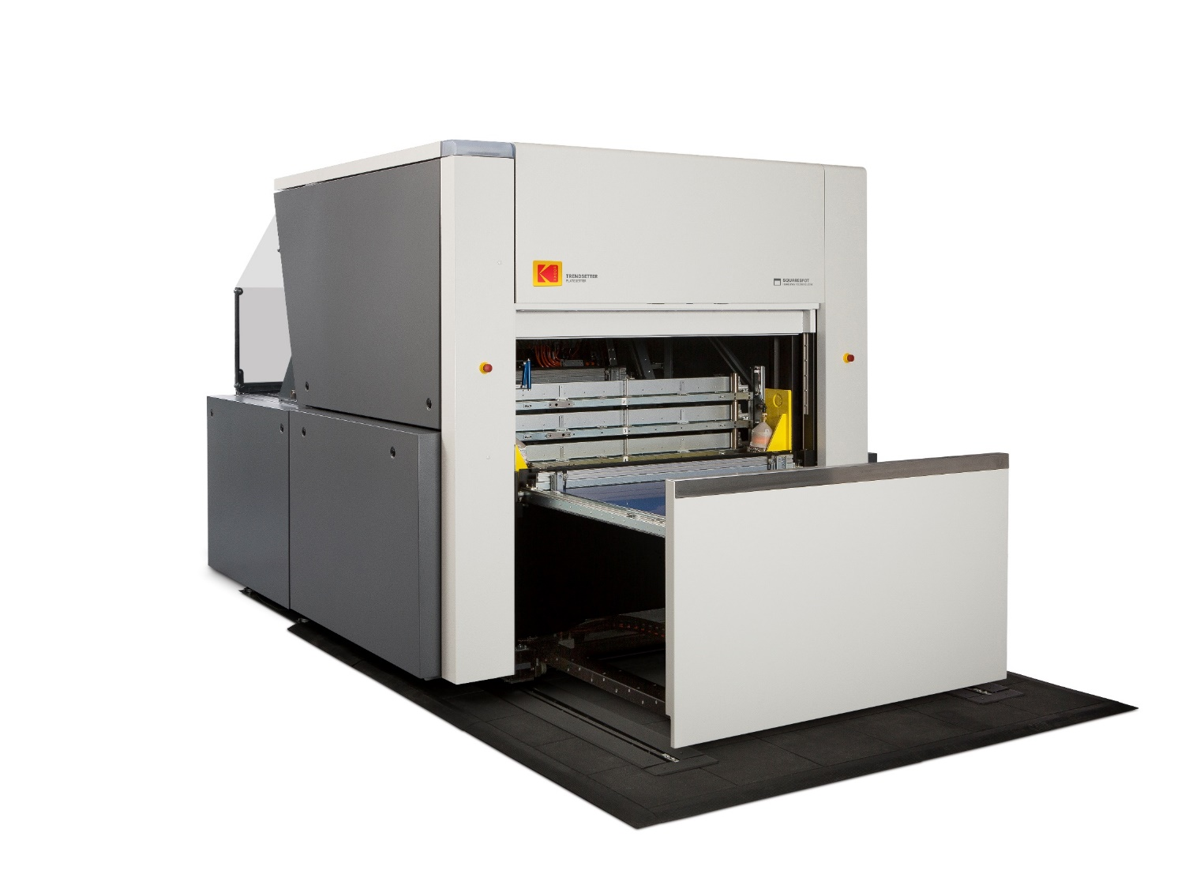
Multi-Cassette Unit automation option
Compact footprint
between 24-65% less than comparable
MCU solutions
Significant power savings
up to 80% less power consumption than
comparable MCU solutions
Rock solid reliability
best-in-class laser heads imaging technology & based on industry’s renowned reliability

Slide 13

Multi-Cassette Unit automation option
 | ACHIEVE T400/T800 and TRENDSETTER Q400/Q800 Platesetters
Capacity | 120 plates per cassette; total max of 480 plates in 4 cassettes
Standard | 2 cassettes Short unload table
Optional | 2 additional cassettes for a total of 4 cassettes Long unload table with rotator (no punch) Post-image punch system with up to 10 punch heads (with short unload table)

Slide 14
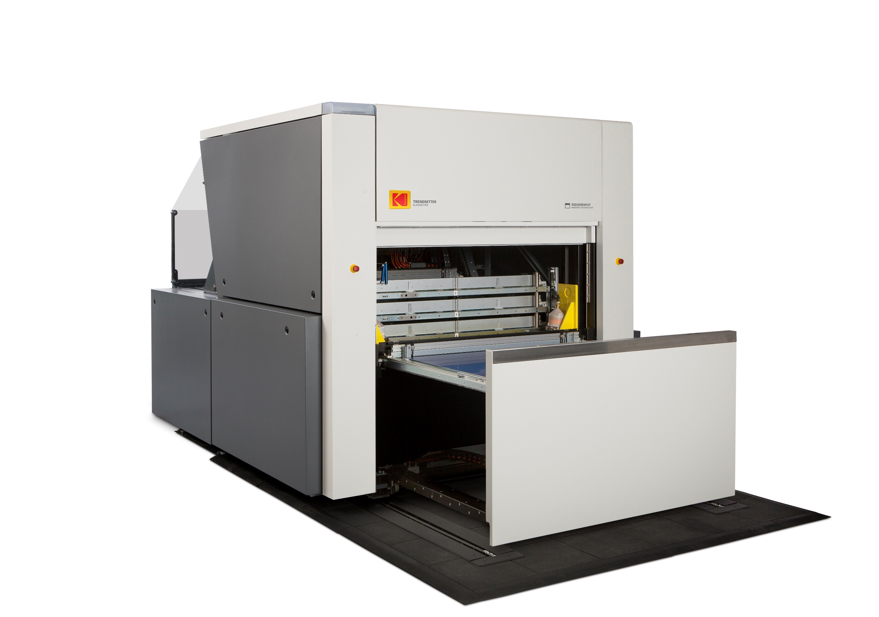
Multi-Cassette Unit automation option
Same plate picking & slip sheet removal system as SCU
Standard: New short non-rotator unload table 0.5 m shorter than long table
Only extra 0.24 m longer than SCU
Vertical Cassette Elevator mechanism
Automatic picker and punch adjustment for different plate sizes
Slip Sheet bin
Very small footprint

Slide 15
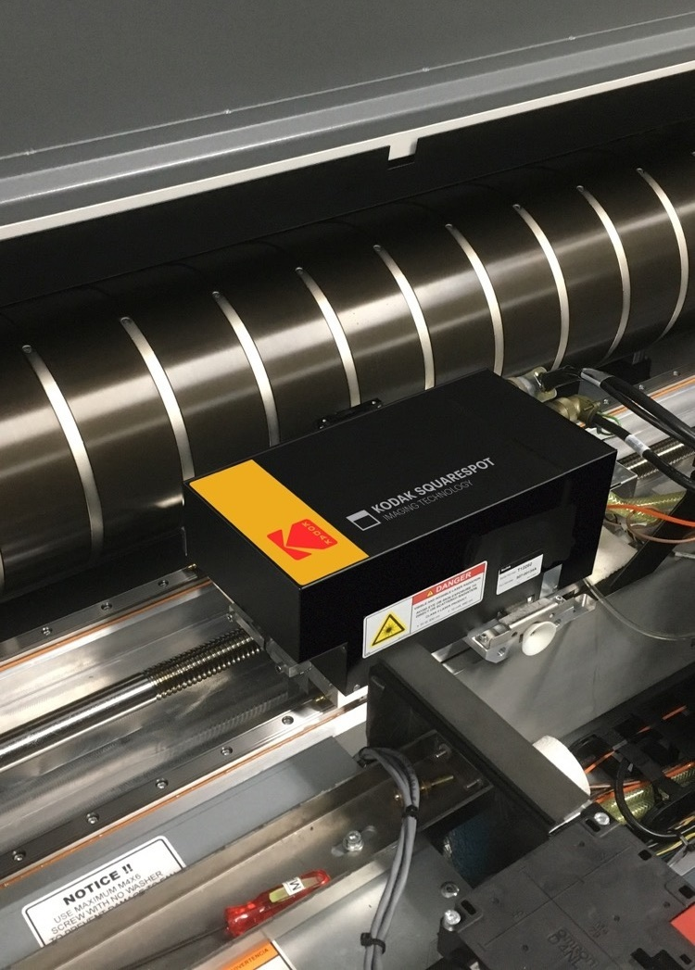
W-Speed option
Faster speeds for TRENDSETTER Q400/Q800 Platesetters in 2019
  75 plates per hour (4-page)
  62 plates per hour (8-page)
Latest high-power SQUARESPOT Thermal Head based on Kodak’s 23-year experience

Slide 16

Power Savings
KODAK CTPs use less power by design:
State-of-the-art electronics
Custom-designed power distribution system
Low-current draw drum drive system
High-efficiency imaging system
High-efficiency cooling system
Optimized mechanical assemblies
 | Power consumption while imaging (watts)*
 | Current model | 2015 model | Competitor A** | Competitor B** | Competitor C**
KODAK ACHIEVE T400 Platesetter | 400 | 700 43% savings | 3,600 89% savings | 700 43% savings | 5,300 92% savings
KODAK ACHIEVE T800 Platesetter | 400 | 700 43% savings | 4,000 90% savings | 600 33% savings | 5,600 93% savings
KODAK TRENDSETTER Q400 Platesetter | 770 | 1,100 30% savings | 3,600 79% savings | 1,600 52% savings | 5,300 85% savings
KODAK TRENDSETTER Q800 Platesetter | 770 | 1,100 30% savings | 4,600 83% savings | 1,600 52% savings | 5,600 86% savings
* Based on public information
** Competitive devices are those that are comparable in terms of specifications and features

Slide 17


JDF/JMF open connectivity
JDF/JMF Connectivity Option enables functionality in the Print Console software to provide job and device status information upstream to other Kodak or third party software
Available as an optional license, per device – factory and field
Requires latest CR for field upgrades including Print Console 5 for ACHIEVE and TRENDSETTER Platesetters
For more detailed information, please review the interface document and procedure, available upon request for 3rd party software custom development
Connectivity with PRINERGY Workflow 8.3; PRINERGY Cloud included with Decision Analytics

Slide 18
4,800 / 5,080 dpi high resolution option
TRENDSETTER Platesetters, all configurations
In response to increasing demand for higher resolution printing –
can be used to image exceptionally small features with complex background patterns, or microprinting that is indiscernible to the naked eye
Special software algorithm –
which doubles pixel addressability in the subscan direction using standard Thermal 2 head
Opens opportunities for new applications –
Microprinting (small text) / Guilloche (swirling pattern)
Security applications
Lenticular applications

Slide 19
New mobile app

Slide 20
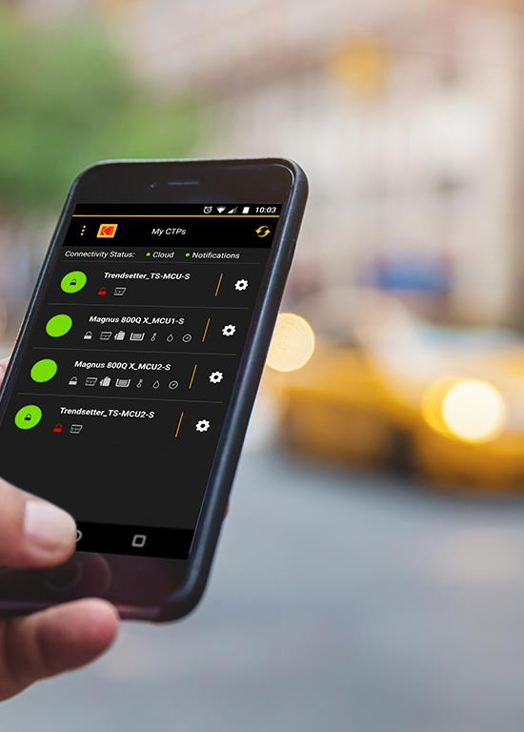
KODAK Mobile CTP Control App
Flexible and proactive monitoring of your
KODAK CTP Devices
for more control and
maximum uptime.

Slide 21
KODAK Mobile CTP Control App
Know immediately when your CTP device needs attention
Operators can stay busy with other tasks, even off site
Eliminate waiting! Attend to the CTP device as soon as:
  it has finished making plates
  more plates need to be loaded
  it stops for any other reason
Remotely check on what is happening
  what job is imaging and what’s next
Manage certain tasks remotely

Slide 22

Superior imaging technology

Slide 23
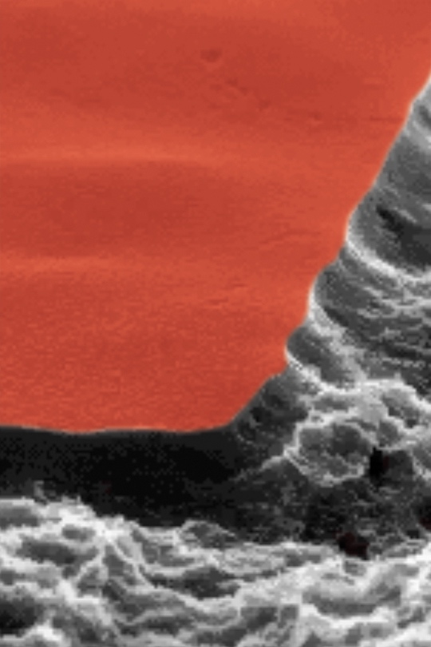

Unique, proprietary technology
  The stability doesn’t come from SQUAREspot’s “SQUARE” shape… it comes from its “SQUARE” edges.
  Steep.
  Unambiguous.
  Stable.
Only on Kodak’s platesetters
Provides:
  Stability
  Accuracy
  Reliability

Slide 24




Imaging technology: Comparison
Competitive
Imaging Technology
SQUARESPOT
TECHNOLOGY
TH5
TECHNOLOGY
GLV
TECHNOLOGY
GAUSSIAN
TECHNOLOGY
The finer the halftone dot, …
… the greater the impact from variation
EDGE
CONTROL
UNSTABLE

Slide 25



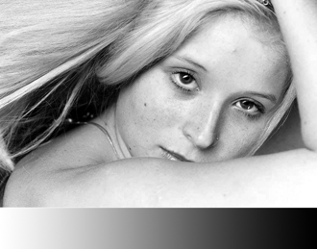
Imaging technology: Comparison
Competitive
Imaging Technology
SQUARESPOT
TECHNOLOGY
TH5
TECHNOLOGY
GLV
TECHNOLOGY
GAUSSIAN
TECHNOLOGY
When exposure is BALANCED … uniformity is good

Slide 26



Imaging technology: Comparison
Competitive
Imaging Technology
SQUARESPOT
TECHNOLOGY
TH5
TECHNOLOGY
GLV
TECHNOLOGY
GAUSSIAN
TECHNOLOGY
0%
+3%
+8%
+4%
+10%
-10%
-5%
0%
0%
+3%
+8%
+4%
+10%
-10%
-5%
0%
0%
+3%
+8%
+4%
+10%
-10%
-5%
0%
0%
+3%
+8%
+4%
+10%
-10%
-5%
0%
When exposure is OUT of BALANCE
… SQUAREspot or TH5
are best

Slide 27
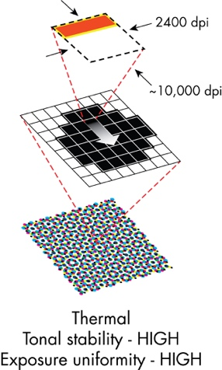
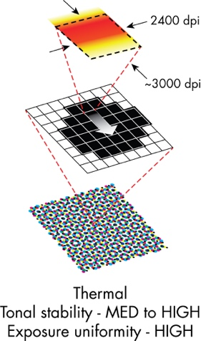
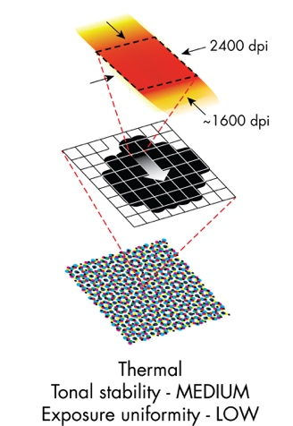
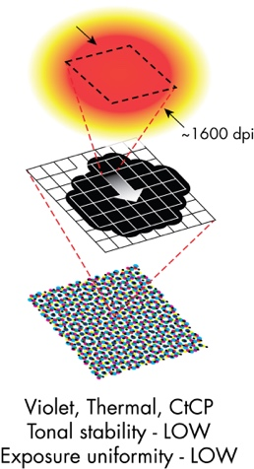
Imaging technology: Comparison
Competitive
Imaging Technology
SQUARESPOT
TECHNOLOGY
TH5
TECHNOLOGY
GLV
TECHNOLOGY
GAUSSIAN
TECHNOLOGY

Slide 28

Unique advantages:
  Highest resolution in the market today
  Includes additional stability enhancements features:
  Dynamic Autofocus
  Lens dynamically adjusts focus as drum rotates.
  Automatic Temperature Compensation
  Automatic scaling for plate expansion
  Geometric Correction
  Factory scaling set up to same master to enable CTP-to-CTP accuracy
Technology focus:
At the core of Kodak’s thermal CTP solution is the fundamental principle
that resolution drives stability
10,000 dpi laser exposes 2400 dpi pixels with greater accuracy, wider exposure latitude and outstanding consistency, power on plate: 23-25 watts

Slide 29
TH5 imaging technology
Unique advantages:
  Cost of ownership
  Power savings up to 43% while imaging compared to its initial design
  Robustness, no moving parts
  Simple service and maintenance
Technology focus:
  Specifications focused on entry level needs, power on plate: 10 watts
  Simplified optics focused on removing complexity and high precision mechanics required high-end specifications
  Easy installation or swap, no calibration

Slide 30
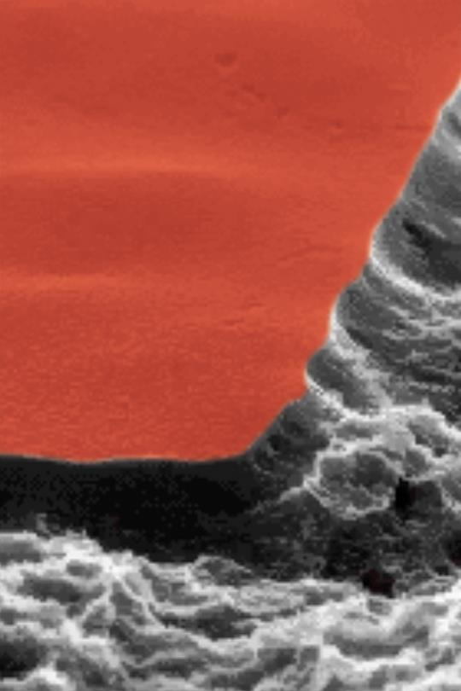
Key imaging technology takeaways
Laser resolution drives stability.
Stability enables printers to differentiate in speed, consistency, cost and quality.
KODAK SQUAREspot Imaging Technology is 10,000 dpi. The highest resolution in Commercial and Newspaper CTP.
SQUAREspot brings further stability with autofocus, temperature compensation and geometric correction.
SQUAREspot delivers at least 6x the stability of Thermal and Visible Gaussian laser technologies.
SQUAREspot delivers at least 3x the stability of Grating Light Valve laser technology.
Through redundancy in the architecture, catastrophic failure can be avoided for some laser failure modes.

Slide 31
Compact footprint

Slide 32
Footprint & weight summary
For KODAK TRENDSETTER Q400/Q800 and ACHIEVE T400/T800 Platesetters
AUTOMATION | CONFIGURATION | HEIGHT (CM) | WIDTH (CM) | DEPTH (CM) | WEIGHT (KG)
SA | Standard | 160 | 200 | 120 | 650
AU | Standard (Short ULT) | 170 | 200 | 127 | 762
 | Rotator (Long ULT) | 210 | 200 | 177 | 772
 | Standard (Short ULT) w/ Punch | 170 | 200 | 245 | 939
AL | Standard (Short) | 184 | 200 | 127 | 796
 | Rotator (Long ULT) | 210 | 200 | 180 | 806
 | Standard (Short ULT) w/ Punch | 184 | 200 | 246 | 973
SCU | Standard (Short) | 193 | 233 | 231 | 1158
 | Rotator (Long ULT) | 210 | 233 | 281 | 1168
 | Standard (Short ULT) w/ Punch | 193 | 233 | 349 | 1335
MCU | Standard (Short) | 191 | 233 | 254 | 1827
 | Rotator (Long ULT) | 191 | 233 | 307 | 1837
 | Standard (Short ULT) w/ Punch | 191 | 233 | 372 | 2004

Slide 33
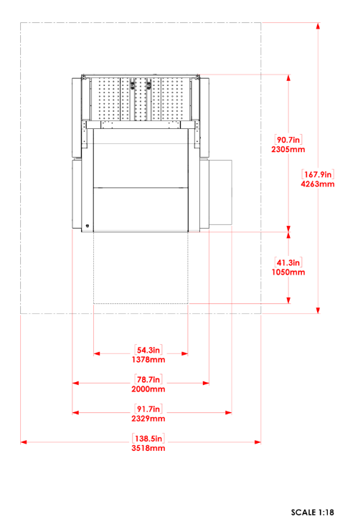
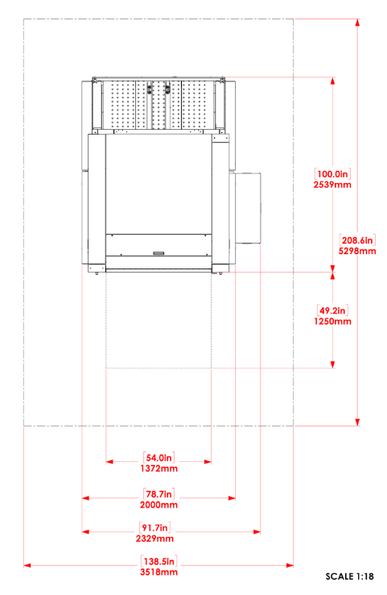
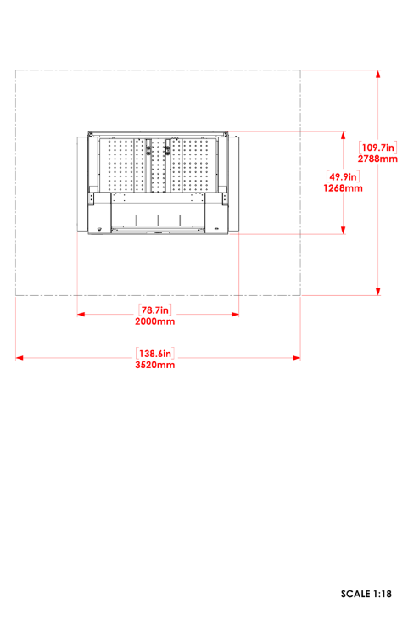
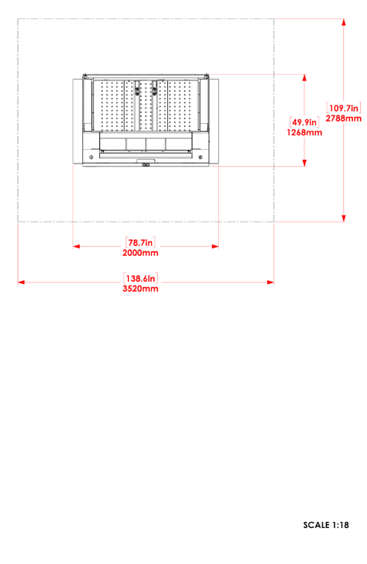
Standard (short) unload table option
For KODAK TRENDSETTER Q400/Q800 and ACHIEVE T400/T800 Platesetters
Auto Unload
(AU)
Auto Loader
(AL)
Single-Cassette Unit
(SCU)
Multi-Cassette Unit
(MCU)

Slide 34
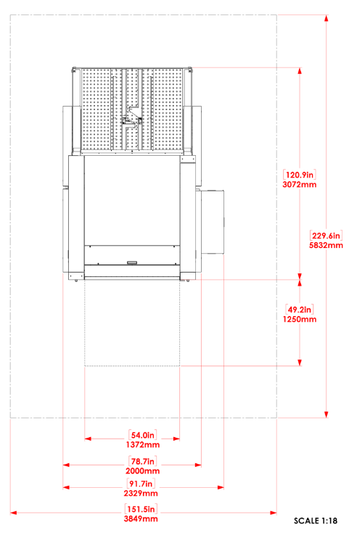
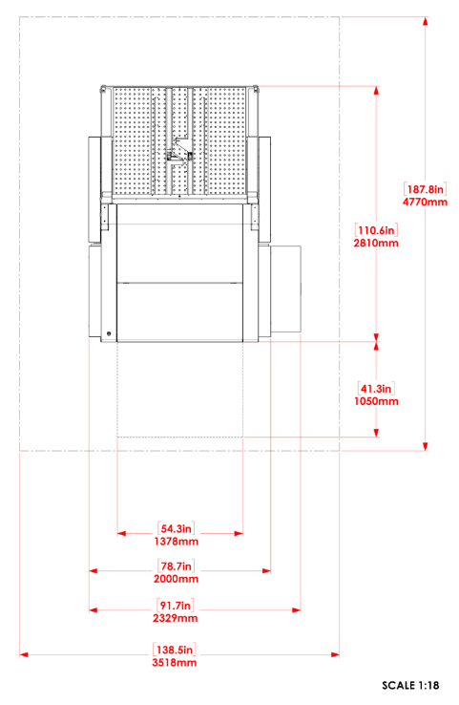
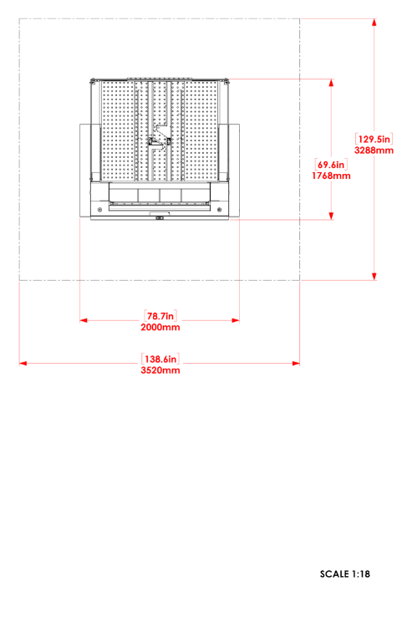
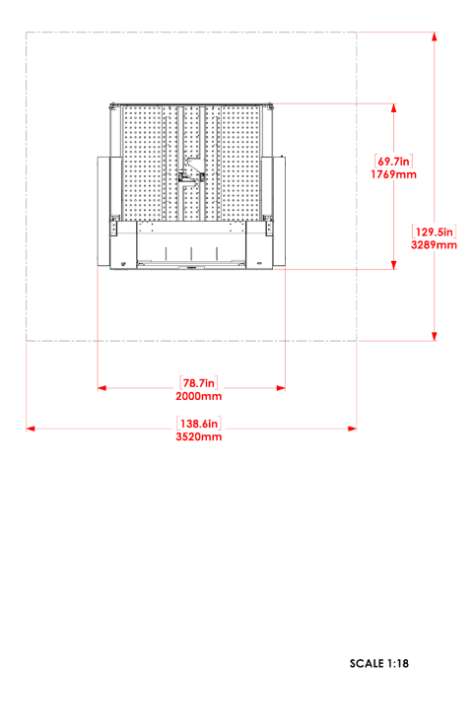
Rotator (long) unload table option
For KODAK TRENDSETTER Q400/Q800 and ACHIEVE T400/T800 Platesetters
Auto Unload
(AU)
Auto Loader
(AL)
Single-Cassette Unit
(SCU)
Multi-Cassette Unit
(MCU)

Slide 35
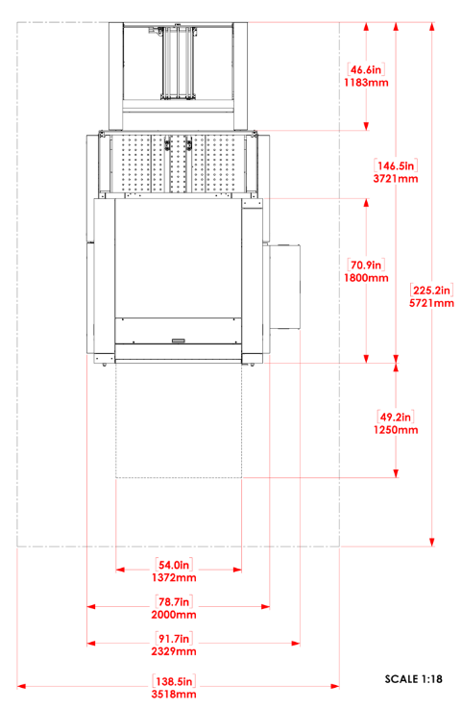
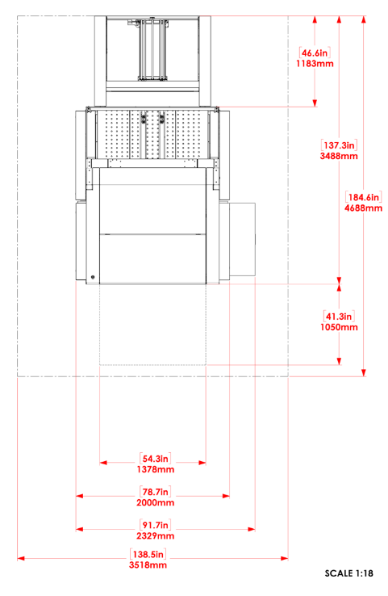
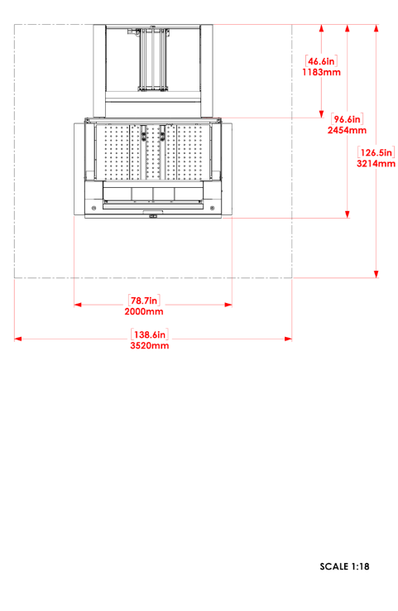
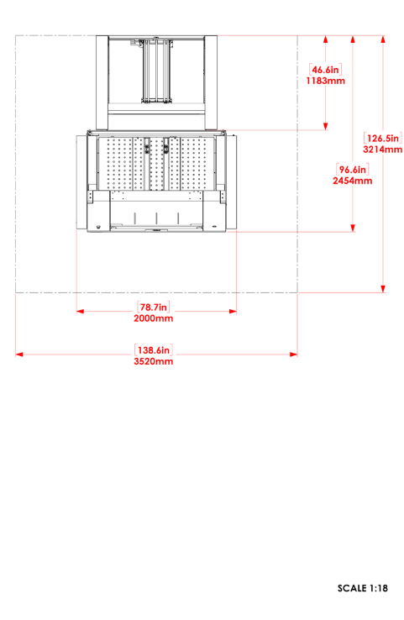
Standard (short) unload table & Punch option
For KODAK TRENDSETTER Q400/Q800 and ACHIEVE T400/T800 Platesetters
Auto Unload
(AU)
Auto Loader
(AL)
Single-Cassette Unit
(SCU)
Multi-Cassette Unit
(MCU)

Slide 36
MCU automation option
For KODAK TRENDSETTER Q400/Q800 and ACHIEVE T400/T800 Platesetters
MCU Standard
(Short ULT)
MCU w/ Rotator
(Long ULT)
MCU Standard
(Short ULT) w/ Punch

Slide 37
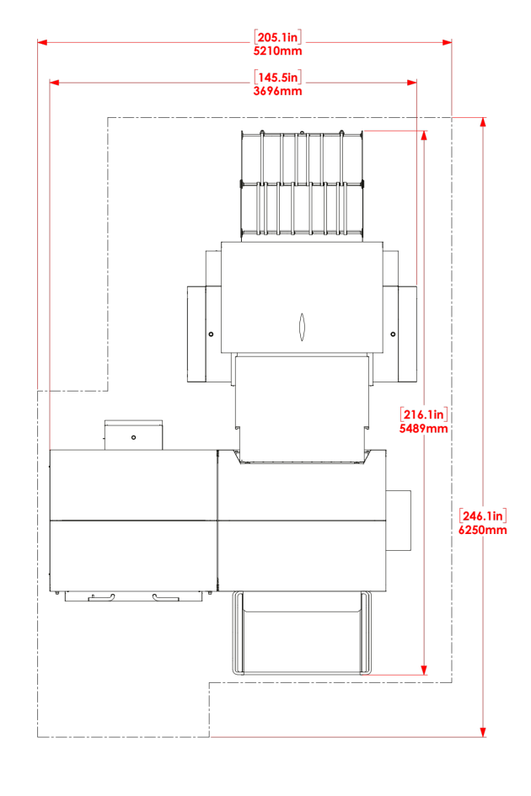
MCU automation option – with processor
For KODAK TRENDSETTER Q400/Q800 and ACHIEVE T400/T800 Platesetters
Physical footprint:
57% reduction
Practical footprint including operator & service access:
38% reduction
More footprint reduction without punch system 45-65%
TRENDSETTER / ACHIEVE Platesetter MCU
Standard (Short ULT) w/ Punch
MAGNUS Q800 Platesetter MCU
With exit conveyor
Notes:
Physical and practical footprint are compared with TS MCU Standard Short ULT) w/Punch configuration
More footprint reduction from MCU with Rotator (Long ULT) configuration

Slide 38
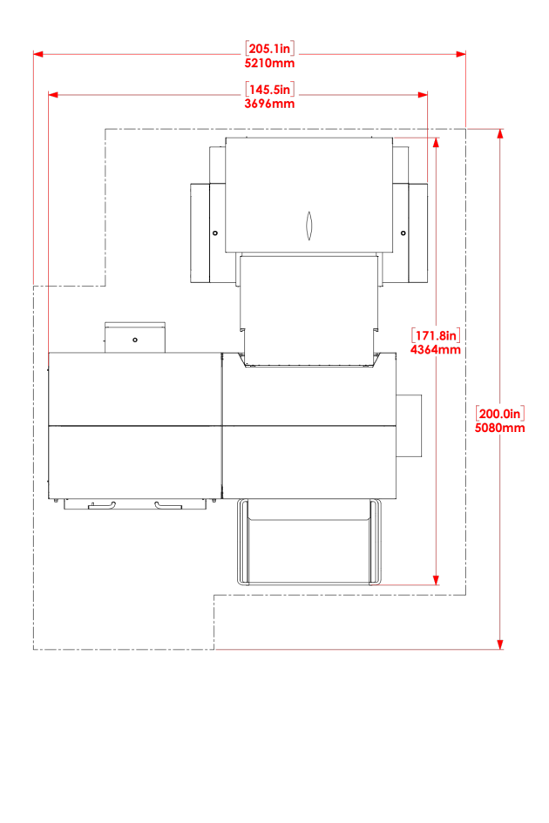
MCU automation option – with SONORA Plates
For KODAK TRENDSETTER Q400/Q800 and ACHIEVE T400/T800 Platesetters
Physical footprint:
46% reduction
Practical footprint including operator & service access:
24% reduction
More footprint reduction without punch system 40-63%
TRENDSETTER / ACHIEVE Platesetter MCU
Standard (Short ULT) w/ Punch
MAGNUS Q800 Platesetter MCU
Without exit conveyor
Notes:
Physical and practical footprint are compared with TS MCU Standard Short ULT) w/Punch configuration
More footprint reduction from MCU with Rotator (Long ULT) configuration

Slide 39
Product enhancements

Slide 40
Coming in Q1 2019: optional device server
Field and Factory option, upgrade for customers who want to invest more in computer hardware to get additional robustness & security compared to standard device workstation
Available for all KODAK CTP Devices
Intended as “device server” with device control software only, no workflow
Additional robustness and security with the following functionality:
  Server operating system – Windows 2012
  Dual power supply
  Dual raid hard drives
Same standard keyboard, mouse and monitor as standard device workstation

Slide 41
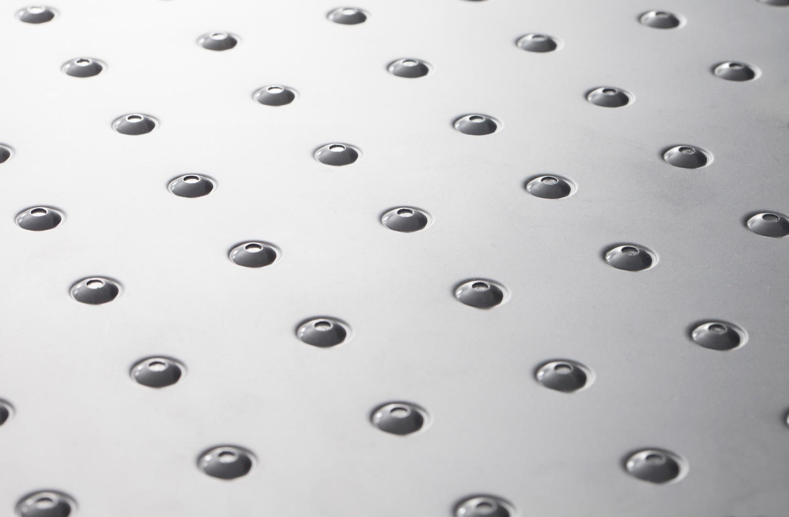
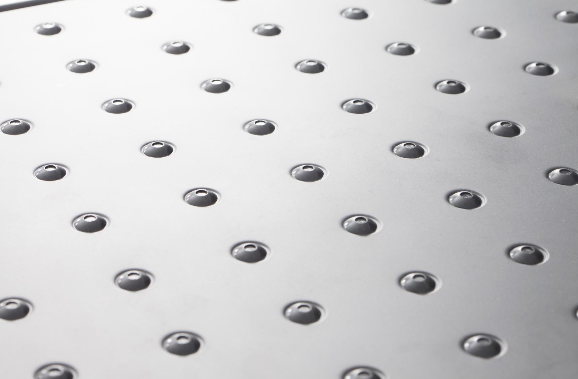
?

Slide 42
Thank you

